Slide 1
LANE LINE DETECTION
Abraham. A

Slide 2
INTRODUCTION
Lane line detection is a critical computer vision application used to identify and monitor lane markings on roadways. Its significance lies in its pivotal role in enhancing road safety and enabling autonomous driving technology. By analyzing lane lines in real-time, autonomous vehicles can accurately determine their position within a lane, make informed decisions about speed and trajectory, and respond to changing road conditions and obstacles.
This technology is also essential for advanced driver assistance systems (ADAS) in conventional vehicles, providing features like lane-keeping assistance and lane departure warnings. Lane line detection thus forms the backbone of modern transportation, promising safer, more efficient, and increasingly autonomous journeys on our roads.

Slide 3
Computer Vision
Computer vision is an interdisciplinary field that enables machines to interpret and understand visual information from the world, replicating human visual perception for various applications, including object recognition and tracking.
OpenCV, an open-source computer vision library, is critical in lane line detection due to its rich toolset, simplifying tasks like image processing, edge detection, and Hough Transform implementation in Python.
Python shines as the primary language for computer vision, thanks to its simplicity, extensive libraries like OpenCV, and a vibrant community, making complex vision tasks accessible and efficient.

Slide 4
Lane Line Detection Process
The lane line detection process involves multiple steps, including image preprocessing to enhance quality, edge detection to identify potential lane markings, region of interest selection to focus on relevant areas, and the application of the Hough Transform algorithm to precisely detect and track lane lines. These steps are crucial in ensuring the safe and accurate navigation of vehicles on the road.
Lane line detection encompasses key stages: Preprocessing readies the image, optimizing clarity. Edge detection, often using Canny, identifies potential lane edges. ROI selection isolates the relevant road area. Finally, line detection with the Hough Transform pinpoints and tracks lane lines, enabling accurate navigation in autonomous vehicles and ADAS.

Slide 5
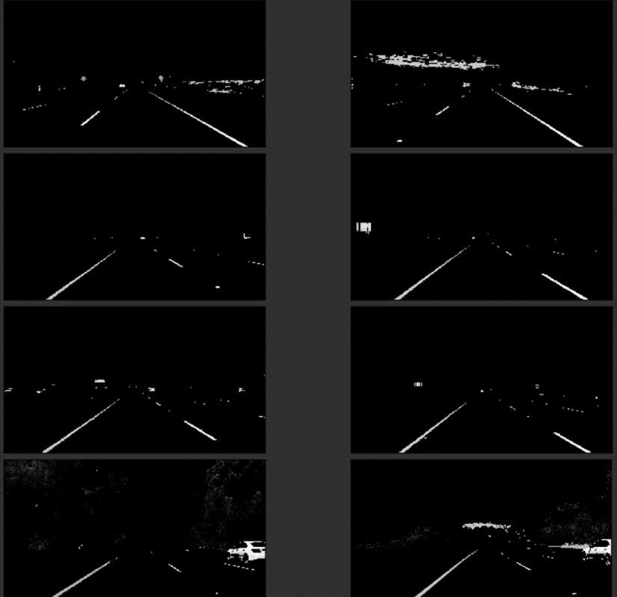
Edge Detection
The Canny edge detector is a widely-used technique in computer vision, including lane line detection. It first smooths the image to reduce noise, calculates gradients to find intensity changes, performs non-maximum suppression to thin the edges, and uses hysteresis thresholding to link adjacent edge pixels. The result is a clean and well-connected edge map, vital for identifying and tracking lane lines in various road conditions.

Slide 6
What Is ROI
ROI (Region of Interest) defines a specific area in an image, isolating the region where lane lines are expected. It reduces computational load and enhances lane detection accuracy by concentrating on the relevant part of the image, ensuring efficient processing for identifying and tracking lane lines in the selected area.
To define a polygonal ROI in lane line detection, select vertices that form a closed shape around the area of interest, such as a trapezoid representing the road region. Use Python's OpenCV library to create a mask using the vertices, which, when applied to the image, isolates the desired ROI for subsequent processing steps.

Slide 7
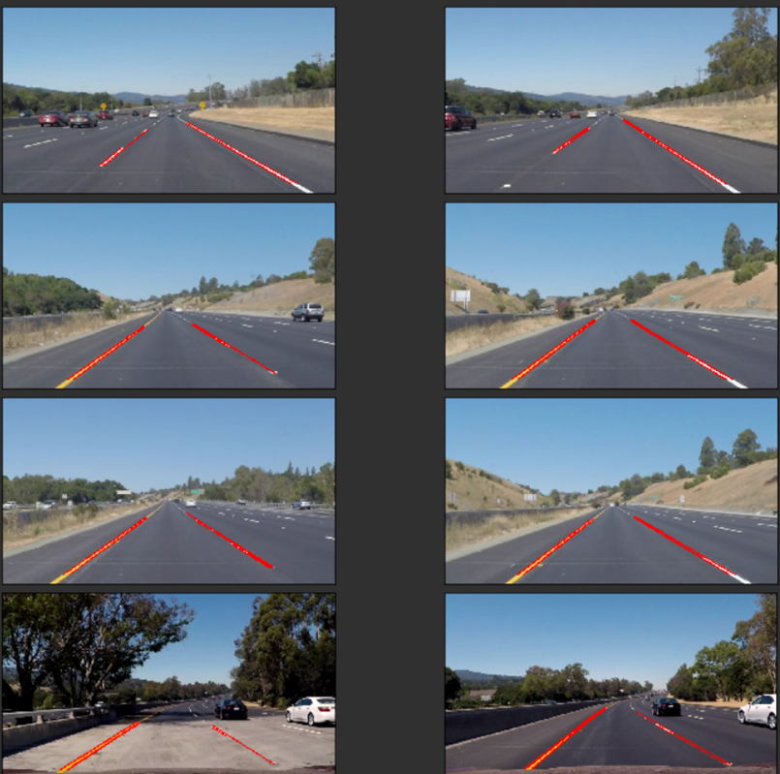
Hough Transform
The Hough Transform is a technique used for line detection in lane line detection and computer vision. It transforms image points into parameter space to identify lines, making it valuable for lane tracking.
In Hough line detection, the key parameters are the rho (distance resolution in pixels), theta (angle resolution in radians), and threshold (minimum vote count) parameters. These values influence line detection accuracy and computational performance.

Slide 8
Conclusion
In conclusion, lane line detection in Python and computer vision is a cornerstone of modern transportation, with far-reaching implications for autonomous driving and road safety. By combining advanced algorithms with the power of Python, we can navigate the complexities of our roadways with unprecedented accuracy and efficiency. This technology promises a future where vehicles are not only autonomous but also safer, more reliable, and better equipped to handle the challenges of our dynamic road environments.
Future enhancements in lane line detection may include real-time environmental analysis, improved adaptive algorithms for varying road conditions, and integration with advanced driver-assistance systems for seamless human-vehicle interaction.

